Slide 1

Nurturing and Developing Business Leaders
Keelin Fagan | November 2020
Head of Client Learning and Development
Enterprise Ireland

Slide 2
Who are Enterprise Ireland
Our approach to developing leaders in Irish start up and SMEs landscapes

Slide 3





The Ecosystem
The Department of Enterprise, Trade and Employment is responsible for leading and coordinating Ireland’s interests at home and abroad, assisted by a number of offices and agencies.
The lead agency responsible for the development and growth of Irish enterprises in world markets.
Provides information and support on starting or growing a business in Ireland.
Promotes and funds the study of STEM to improve the competitiveness of Irish enterprises.
Ireland’s inward investment promotion agency.

Slide 4
About Enterprise Ireland
Enterprise Ireland is the state agency responsible for the development and growth of Irish-owned companies in global markets.
As a major seed capital investor we help our clients to start, grow, innovate and win export sales.
Work with 5,000 Irish-owned businesses, early-stage entrepreneurs, established businesses and Irish multinationals, Irish-directed mid-caps and corporates
Manufacturing sector and internationally-traded services with 10 or more employees
Leadership, competitiveness, innovation, networking and financial supports made to match ambition at every stage
Mandate to drive collaboration and commercialisation of state-funded research
Key focus is the development and growth of Irish companies in global markets
1
2
3
4
5

Slide 5
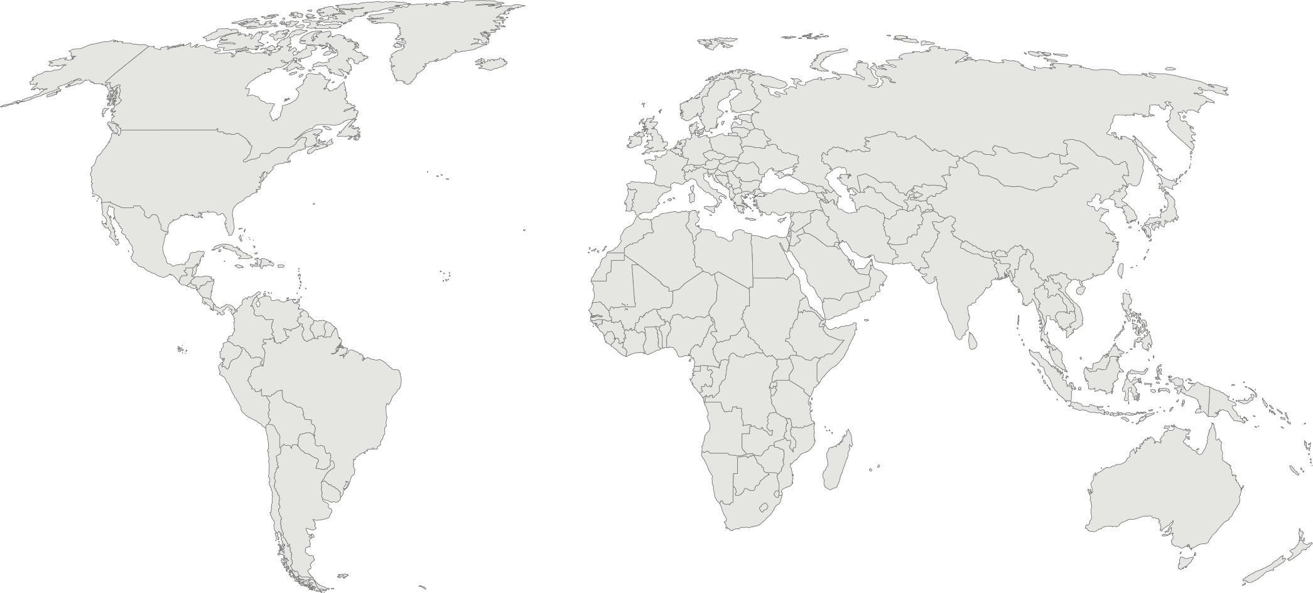








39 international offices; 10 regional offices in Ireland
Enterprise Ireland International Offices
USA & Canada
Boston *
Chicago
New York *
Silicon Valley *
Austin, Texas
Toronto *
Southern Europe, Middle East, Africa & India
Milan
Madrid
Dubai
Riyadh, Saudi Arabia
Johannesburg
Istanbul, Turkey
Delhi
UK, Northern & Western Europe
London
Manchester
Paris
Amsterdam *
Brussels
Dusseldorf
Stockholm *
Central Europe, Russia, CIS, South America
Prague
Budapest
Warsaw
Moscow
Sao Paulo, Brazil *
Asia Pacific
Beijing *
Shanghai *
Hong Kong
Tokyo *
Seoul *
Singapore *
Sydney
New office
Expand existing office
New presence
* Indicates Incubators

Slide 6




Enterprise Ireland
Building Irish international business
What
Start
Scale
Innovate
Reach
Why
Who
5,000 clients, from high potential start-ups to established businesses and Irish multinational companies
Exports
+€5bn to €26bn p.a.
67% outside UK
Jobs
+60,000 new jobs
Maintain existing jobs throughout Ireland
R&D
+50% spend to €1.25bn p.a.
How
Strategy development
Leadership & management development
Export assistance
Access to
market-led research & innovation
Funding
Support
Ecosystem development

Slide 7


















Irish International Businesses

Slide 8



Key Challenges 2020
Global issues converge
Brexit
Climate
Change
Technological
Disruption
Covid 19
Global Trade
& Tariffs
Develop Customised Leadership Development Supports; designed to help our clients address and respond to these key challenges
Notes:
Following a really strong performance 2019,
Irish exporters have since encountered a number of challenges …..

Slide 9
Leadership Development Supports
Enterprise Ireland inspire Irish business leaders to have the ambition, confidence and ability to grow their businesses globally, through our suite of tailored programmes, mentor supports and digital learning offers.
eiLearn our Elearning platform designed to inspire and motivate
Mentoring support offering advice and support to companies to help them grow their business internationally
Customised strategic programmes that create transformational change
Flexible programmes that address short term day to day business issues

Slide 10
Critical development needs help our clients grow their exports
Strategy
Strategic Business Planning
Clear implementation plan – measurable KPIs
Financed, resourced and communicated across the business
People and Management
Vision & Values - business results
Attracting & Retaining Talent - skills gaps
Organisational Structure – capability gaps, succession
HR Processes – drive Performance
Sales & Marketing
Robust Sales and Marketing strategy to deliver business growth - clear value proposition
Continuous market intelligence gathering – understanding and addressing customer, competitor and market needs
Lead Generation & Channel Management
Manage people and financial resources to deliver sales
Finance
Develop, implement and fund their strategic plan
Manage working capital and cashflow management – data to support growth
Identify and access appropriate sources of funding
Operations
Develop an agile organisation, practically applying lean, agile and six-sigma practices
Manage global supply chains
Drive operational performance through a focus on productivity measurement and efficiencies
Innovation
Build innovation leadership, skills and culture
Innovating in a Crisis - Identify relevant innovation opportunities to facilitate business growth
Implement a design-driven innovation approach

