Slide 1

Transforming Leadership Learning
Dan Jenkins, Ph.D.
Chair and Associate Professor, Leadership & Organizational Studies
University of Southern Maine, U.S.A.

Slide 2
Agenda
Why?
Leadership Learning Framework
Model of Leader and Follower Experiences as a Source of Transformational Learning
Audience Participation
Q&A

Slide 3

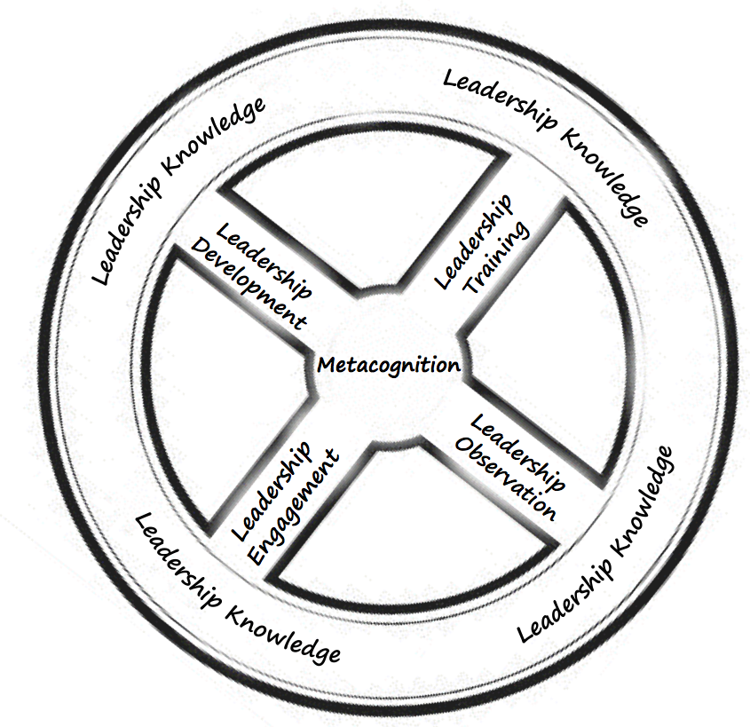
Why a Leadership Learning Framework?
Notes:
Roberts and Ullom (1989) provided training, education, and development (TED model) as the way we should approach leadership learning.
6 areas build upon many scholars’ work in various facets of learning, teaching, and education
Resulting in a framework that challenges leadership educators to rethink leadership learning.
Metaphor of a steering wheel- students steer their own learning, but also for educators to better understand the multiple ways in which students learn.
A teaching strategy can take one or several into consideration

Slide 4
Leadership Knowledge
Acquire information and critical insights about leadership
Cognitive in nature
Heavy emphasis on acquisition and mental processing
Most widely-used leadership frameworks (Rosch & Anthony, 2012)
  Social Change Model of Leadership Development (HERI, 1996)
  Relational Leadership Model (Komives, McMahon, & Lucas, 2013)
  Five Practices of Exemplary Leadership (Kouzes & Posner, 2012)
Notes:
Leadership knowledge acquisition occurs in all programs
Even just by using language about leadership that may not have been used previously
Most widely-used leadership frameworks guide leadership programs

Slide 5
Leadership Knowledge
Pedagogies
(Teaching Strategies)
Assessment
(of Learning)
Lectures Reading Pair-Share-Report Case Studies Peer Facilitation Bringing in Current Articles Art Creation of Leadership Artifacts Dramaturgy (acting theory) Flipped Classroom 1 Minute Papers | Tests Quizzes Written Assignments Poster Presentations Blogs Papers Discussion (Face-to-Face and Online) Application of Theory-to-Practice Reading Critiques
Notes:
Which onces can be used for co-curriculuar? (Discussion and Application)

Slide 6
Leadership Development
Human and interpersonal aspects of leadership learning
Individual focus
Specific areas include:
  Values and needs
  Personal motivation and readiness to lead
  Identity
  Multiple dimensions of self
Notes:
Leadership development focuses on relationships as well as opportunities to integrate and understand a group
Leader development focuses on the individual; one’s intrapersonal growth and opportunity to understand the self.
Through enhancing an individual’s knowledge, skills, and values, one can build human capital as a leader.

Slide 7
Leadership Development
Pedagogies
(Teaching Strategies)
Assessment
(of Learning)
Personal Mission Statements/Philosophies One-on-One Discussions Values-Based Boards/Videos Visioning Boards Mind Mapping Storytelling | 1 Minute Reflections Self-Assessment Instruments Role Plays Survey Social Identity Activities Reflective Papers Small Group Discussions

Slide 8
Leadership Training
Skill- and competency- based
Most often used in co-curricular programs
Heavy emphasis on scaffolding
Goal is improved performance on specific tasks
Notes:
Most often used for training positional student leaders
Scaffolding- practice and build upon lessons toward mastery and observable behavioral change.

Slide 9
Leadership Training
Pedagogies
(Teaching Strategies)
Assessment
(of Learning)
Simulations Practice/Repetition Role-play Skill-Based Instruments Debate Peer Critical Feedback | Rubrics Checklists Role Plays Ropes Course Online Feedback for Group Mentorship Art/Visual Representation of Learning Scenario Practice Peer/Instructor Evaluation

Slide 10
Leadership Observation
Social, cultural, and observational aspects
Constructivist in nature
Learner is passive recipient of learning
Learner is making meaning about observation
Two ways of “looking with intention” (Mitra, 2011)
  Inductive looking
  Deductive looking
Notes:
Learning is always culturally bound
Inductive looking- look in order to make sense of the world- introduced to new concepts, interactions, and relationships. Is focused on purely description
Deductive looking- observing in which inferences are made from previous experiences. Conclusions are from principles we infer
Effective observational learning incorporates both inductive sense-making and deductive conclusions about ourselves, others, and the world around us.

Slide 11
Leadership Observation
Pedagogies
(Teaching Strategies)
Assessment
(of Learning)
Lectures Shadowing Witnessing Group Dynamics Service-Learning Videos/Movie Watching Field Assignments Environmental Scans | Reflective Blogs Reflective Journal Entries Reflective Essays Presentations on Findings One-on-One Discussions Article Critique Papers Rubrics

Slide 12
Leadership Engagement
Experiential
Relational
Interactional
Interpersonal
Learner is active participant
Notes:
Learners construct meaning in response to direct and personal encounters with activities of leadership
Constructivist in nature (nature of learning that focuses on how humans make meaning from their experiences)

Slide 13
Leadership Engagement
Pedagogies
(Teaching Strategies)
Assessment
(of Learning)
Action learning Case-in-point Problem-based learning Discussion Groups Service-learning Reflective practice Positional and non-positional experiences Games Debate Theatre of the Oppressed (Social Justice Theatre) Team-Building Activities | Presentations Discussion Feedback Cards- Reading Out loud Synthesis Paper Group Paper

Slide 14
Leadership Metacognition
Learner is critically aware and understand own thought process
Mindfulness of one’s own knowledge and ability to recognize, control, and employ one’s cognitive processes
Complex in nature
  Reflective
  Systemic
  Analytical
  Evaluative
  Adaptive
  mindful
Notes:
Metacognition sits at the heart of leadership learning because without critical thought and reflection of the learning experience, we cannot make meaning or begin to apply and adapt what we learn.
Critical thinking is essential
3-phase metacognition process
Planning
Monitoring
Evaluation

Slide 15
Leadership Metacognition
Pedagogies
(Teaching Strategies)
Assessment
(of Learning)
Reflection Essays Case Study Analysis Simulation and role play Field work Environmental assessment Group/discussion facilitation Critical leadership Provocative Statements Feedback What? So What? Now What? | Reflection Essays Reflective Blogs Reflective Journal Entries Intergroup Dialogue Poster Presentations Start-Stop-Continue Values Self-Portrait Synthesis Paper

Slide 16
Leadership Learning Framework

Slide 17

Leadership Education Should Be Transformative:
What does that look like in practice?
Notes:
What does that look like in practice?

Slide 18
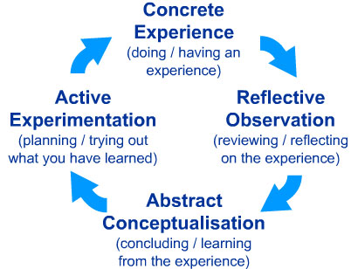
Model of Leader and Follower Experiences as a Source of Transformational Learning
Who here is familiar with Kolb’s (1984) Model of Experiential Learning?

Slide 19
Model of Leader and Follower Experiences as a Source of Transformational Learning
Then you’ll love Guthrie and Jenkins’s (2018) Model!
Experience as a Leader or Follower
Critical Reflection
Experiential Abstraction
Metacognitve Discovery and Exploration

Slide 20
Model of Leader and Follower Experiences as a Source of Transformational Learning
Stage 1: Experience as a Leadership or Follower
Any experience(s) an individual might have in a leader or follower role.
Individual does not have to be in a formal leadership role nor an active participant.
Most experiences that contribute to leadership learning involve the individual in a follower role (Chaleff, 2009; Kellerman, 2008, 2012).
Experience as a Leader or Follower
Notes:
LFESTL

Slide 21
Model of Leader and Follower Experiences as a Source of Transformational Learning
Stage 2: Critical Reflection
Iterative process of reflecting on experience synthesizing lessons, conclusions, uncertainties, and questions (Harvey & Jenkins, 2014; Owen, 2016).
Experience as a Leader or Follower
Critical Reflection

Slide 22
Model of Leader and Follower Experiences as a Source of Transformational Learning
Stage 3: Experiential Abstraction
Meaning making from the critical reflection of their experiences as a leader or follower (Baxter Magolda, 2001; Kegan, 1994).
Experience as a Leader or Follower
Critical Reflection
Experiential Abstraction

Slide 23
Model of Leader and Follower Experiences as a Source of Transformational Learning
Stage 4: Metacognitive Discovery and Exploration
Learner can experiment with new behaviors and skills, while self-monitoring in the present.
Learner is practicing a heightened metacognition of leadership and followership.
Experience as a Leader or Follower
Critical Reflection
Experiential Abstraction
Metacognitve Discovery and Exploration

Slide 24

Model of Leader and Follower Experiences as a Source of Transformational Learning
ACTIVITY: One-Minute Paper!
Please think about a time where you either received or provided feedback and what you learned from that experience.
Jot down some of your thoughts.

Slide 25
Model of Leader and Follower Experiences as a Source of Transformational Learning
Now, share the following with a partner:
Name the experience and choose leader or follower role. (Stage 1)
Describe what you wrote in your one-minute paper. (Stage 2)
What assumptions or perceptions based on your life experiences did you have during the feedback exchange? (Stage 3)
What did you learn and what growth opportunities were presented? (Stage 4)
Experience as a Leader or Follower
Critical Reflection
Experiential Abstraction
Metacognitive Discovery and Exploration

Slide 26

Q&A

Slide 27
THANK YOU!!
Daniel M. Jenkins, Ph.D.
Chair and Associate Professor, Leadership & Organizational Studies
University of Southern Maine
daniel.m.jenkins@maine.edu
@Dr_Leadership

