Slide 1





Engaging leadership students in an online learning space?
Dr Breda McTaggart: Head of Department, Institute of Technology Sligo

Slide 2

Today
Context.
Explore how to nurture and support student engagement
Some examples in practice.
Time for questions.

Slide 3

IT Sligo
Delivering online for almost 20 years.
30,000 graduates.
Established IT infrastructure and Community of Practice.
Department of Social Sciences and the Arts joined this journey in 2013.
Published in the field (McTaggart, 2015, McTaggart et al., 2016 & 2018).
Master of Arts in Professional Leadership built around idea of accessibility, supported through digital technology.

Slide 4
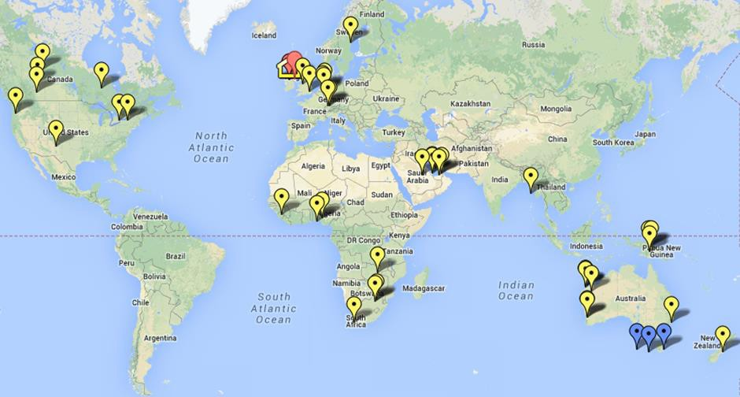
Why online?
Marquart and Counselman-Carpenter (2017), who conclude that “one social justice victory of online education is the ability to expand access to higher education and serve a diverse student body.”

Slide 5
Student Engagement & Student Success
Student engagement is a combination of student involvement and interest in their learning process and their level of connectedness to their faculty and peers (Axelson and Flick, 2011; Meyers, 2014).

Slide 6

All on a journey
Student Engagement
  Student
  Academic
  Organisation

Slide 7
The Online Journey
Student
Novice
Intermediary
Expert
Academic
Novice
Intermediary
Expert
Organisation
Novice
Intermediary
Expert

Slide 8
Student Engagement
Year One-Novice
Challenges
  Understanding the Technology
  Understanding the Content

Slide 9

Organisation-
IT SligoExpert
Infrastructure
Resources
Training

Slide 10
Academic
Where are you i.e. Novice, Intermediary, Expert?
Subject Expert/Teaching and Learning Experts
  Not all subject experts are teaching and learning experts.

Slide 11
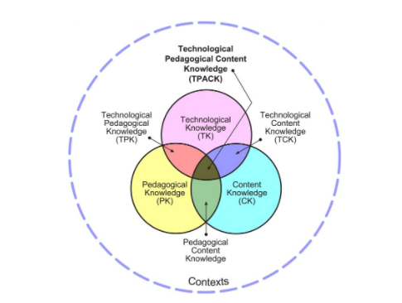
Teaching, Learning and Assessment
Technological pedagogical content knowledge (TPACK) (2006). (Technological knowledge (TK), pedagogical knowledge (PK), and content knowledge (CK) (Mishra, and Koehler, 2006).
T: How confident are you in the online spaces?
  How can you improve this confidence? One small step at a time.
C: Your content, how do you wish to frame it.
P: Use co-constructed learning as the model of teaching and learning (Petty, 2009, 2017).
P: Prepare your virtual classroom, it is as important as setting up a traditional classroom.

Slide 12

Academic Journey: Novice, Intermediary..
2015
Moving in time to a digital tune (McTaggart, 2015)
2016
A big day out or repent at leisure (McTaggart et al., 2016)
2018
A Road Less Travelled, a Road Nonetheless (McTaggart et al., 2018)

Slide 13
IT Sligo-Masters in Professional Leadership
Aim- To bring ideas of professionalism and concepts of professional practice into mainstream leadership practice.
Goal-To support career progression, diversification and self-actualisation.
Delivery Model - Online live lectures. Residential once per term, live-streamed and recorded.
Two years part-time-
Year One- Theoretical
Year Two-Research
Profile of learner-
Diverse backgrounds
Practice /Theory

Slide 14


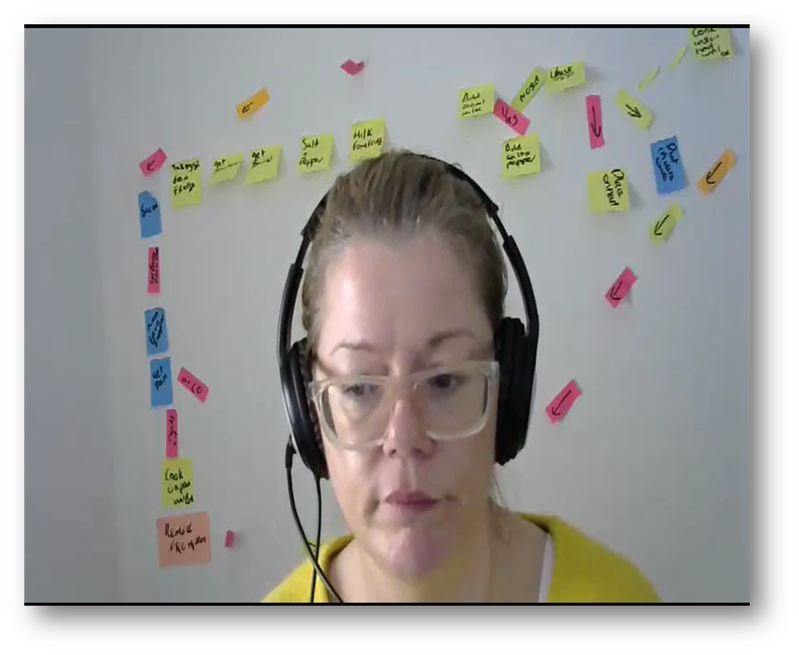





Examples in my own learning spaces for Leadership engagement within a TPACK frame

Slide 15

Online learning is normal learning.

Slide 16

Questions Welcome

Slide 17

References
Axelson, R. D., and Flick, A. (2011). Defining student engagement. Change, 43, 38-43. doi:10.1080/00091383.2011.533096.
McTaggart, B. (2015). Moving in time to a digital tune. 12th International Conference on Cognition and Exploratory Learning in Digital Age. Conference Proceedings. October 2015. Peer-reviewed Conference Paper.
McTaggart, B., Doherty, A., and O`Murchu, C. (2016). Becoming engaged: A big day out or repent at leisure? RAISE16 (Research, Advancing, and Inspiring Student Engagement Conference). Loughborough University. September 2016.
McTaggart, B., Doherty, A., and O`Murchu, C. (2018). A road less travelled, a road nonetheless. The All Ireland Journal of Teaching and Learning in Higher Education. Vol 10, No 3 (2018).
Meyer, K. A. (2014). Student engagement in online learning: What works and why. ASHE, Higher Education Report, 40(6), 1–114. doi:10.1002/aehe.2001
Mishra, P., and Koehler, M. J. (2006). Technological pedagogical content knowledge: A framework for integrating technology in teachers’ knowledge. Teachers College Record, 108 (6), 1017–1054.
Petty, G. (2009). Evidence Based Teaching 2nd Ed, Oxford University Press.
Petty, G. (2017). How to be Better at Creativity, Rosendale Books.
Zepke, N. (2011). Understanding teaching, motivation and external influences in student engagement: how can complexity thinking help?, Research in Post-Compulsory Education, 16(1), 1-13, DOI: 10.1080/13596748.2011.549721 Marquart, M. and Counselman-Carpenter, B. (2017). Supporting the success of online students who are deaf, Columbia University Academic Commons. Retrieved from: https://doi.org/10.7916/D8V12B58.

